Slide 1
DevOps Prep

Slide 2
Content : 1. Git/GitHub : Version Control
2. Application Package : .NET and Java : Code
3. CICD : Continues Integration and Continues Deployment (Jenkins, Azure DevOps) 4. SonarQube 5. Docker 6. Infrastructure as Code : Terraform 7. Kubernetes
8. Azure , AWS (Server, Coud VPC , EC2, S3 , VM , AKS , App Services , EKS , IAM)
9. End to End Application Deployment on AKS and EKS 10. Python 11. Linux

Slide 3
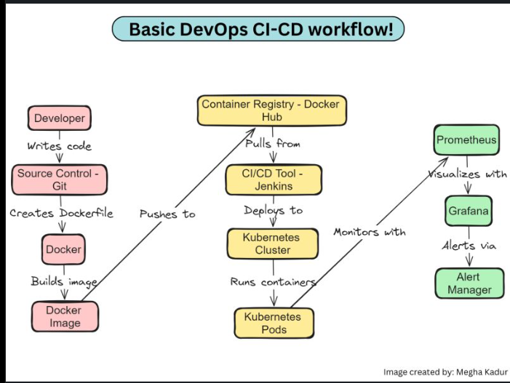
Container Registry ACR
Build Application
CI Part run by -Jenkins
CD Part run by -Jenkins
monitoring

Slide 4
Git/GitHub
Git is a Distributed Version Control System (DVCS)
Tracks changes in code
Allows multiple developers to collaborate
👉 Simple line: “Git helps you track, manage, and collaborate on code changes.”
Basic Git Workflow
Create/modify file
Add to staging
Commit changes
Push to remote/central repo

Slide 5
Important Git commands for Daily use
git init # Initialize repo
git clone <url> # Copy repo
git status # Check changes
git add . # Add files
git commit -m "msg" # Save changes
git push # Upload code
git pull # Get latest code

Slide 6
Branching strategy
Main branch in which DevOps Team merge the changes
Development branch in which Developer push the code
Featured branch in which Developer is working

Slide 7
Interview Question on Git 1. What is git/github 2. what is your branching strategy :- We create our feature branch and done our changes and push the changes into the master branch. 3. what is git rebase 4. what is git webhooks 5. what is source code 6. what is Difference between continuous Deployment and Continuous Delivery.

Slide 8
Application Package : .NET and Java : Code
Application Packaging (.NET & Java)
What is Application Packaging?
Converting source code into a deployable format
Output = artifact
👉 Examples:
Java → .war
.NET → .dll, .exe In the build step, we compile the code and package it into a deployable file like a WAR Why Packaging is Important :-
Ready for deployment
Consistent builds
Easy to share
Used in CI/CD pipelines

Slide 9
Java Build Tools
Maven
Gradle
Most common: Maven
Maven Project Structure
project/
├── src/
│ ├── main/java
│ └── test/java
├── pom.xml pom.xml is the file that tells Maven how to build your project. Maven automatically downloads required libraries Controls how your app is built (WAR/JAR)
Packaging = converting code into something we can run or deploy.”
In DevOps, we don’t deploy source code — we deploy artifacts

Slide 10
Interview question on Maven 1. what is maven 2. what is pom.xml :- Contains all the Dependency Configuration which is help to maven to build the application 3. which build tool you are using for building Java Application :- Maven 4. command use to build the application through Maven mvn clean mvn build mvn package

Slide 11
CICD : Continues Integration and Continues Deployment
What is CI/CD?
🔹 Continuous Integration (CI)
Developers push code frequently
Automatically build & test
🔹 Continuous Deployment (CD)
Automatically deploy to server

Slide 12
CI/CD : Flow Jenkins
Git checkout
SonarQube
Build Application
Build Images/Deployment container
Push image to the Container registry
Alert Manager
Grafana
Prometheus
Deploying to the K8
K8 Pull the latest image from the Container registry

Slide 13
Interview Question on CICD :- 1. what is your CI/CD Flow :- 2. In which step you have integrated your test cases as well. :- the tool which we used is SonarQube and its integrated before our build application. 3. which model you follow continuous Delivery or continuous Deployment.

Slide 14
Jenkins What is Jenkins?
Jenkins is an automation server used to:
Build applications
Run tests
Deploy applications
👉 In short: “Jenkins automates the DevOps pipeline.
Why Jenkins?
Automates repetitive tasks
Faster delivery
Reduces manual errors
Continuous Integration & Deployment

Slide 15
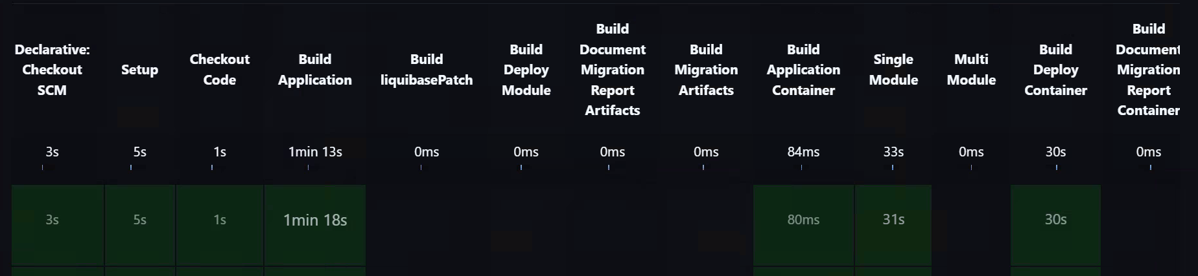
Continous Integration Part of Jenkins
Git checkout step
In this step image is getting created docker image
In this step we are pushing our image to the container registry
Build Application step : War file is creating

Slide 16
Jenkins Master Slave Architecture
1. Master (Controller)
👉 The brain of Jenkins
Responsibilities:
Manage jobs
Schedule builds
Store configuration
Provide UI
Assign work to agents
2. Slave (Agent)
👉 The worker machine
Responsibilities:
Execute build jobs
Run scripts (Maven, .NET, etc.)
Perform testing
Deploy applications

Slide 17
Jenkins Master Slave Architecture Flow
Developer push code to the git
Jenkins Master receives trigger
Agent Executes
Build
Test
Deployment
Result Sent back to Master

Slide 18
Groovy Script format in Jenkins pipeline{
agent any
tools{
jdk 'jdk17'
nodejs 'node16'
}
environment {
SCANNER_HOME=tool 'sonar-scanner'
}
stages {
stage('clean workspace'){
steps{
cleanWs()
}
stages {
stage(‘checkout git code’)

Slide 19
Interview Question on Jenkins :-
1.What is agent in Jenkins :- Agent are the machine on which our Pipeline is run it need a platform on which it executing the script and run all the required dependencies to execute that build 2. what is master slave Architecture and flow. 3. what is Jenkins file :- Jenkins in which it contains all the instruction what our pipeline needs to do 4. what is the language is written in the Jenkins file :- its written in groovy 5. you want to run the pipeline on any specific agent then how will you do that :- 6. Jenkins Shared Library and how to use or how to define in your Jenkins file :- @Library('my-shared-library’) _ 7. Pipeline Slows Down Over Time (Builds taking more time) — How Will You Fix?
8. what is Jenkins Parallel Pipeline. :- we are executing multiple pipeline at a same time wheather to execute them in the queue.
9. what if you ci/cd pipeline is slow what steps you can do resolve that issue.

Slide 20
SonarQube. SonarQube code analysis tool 1. it will test the quality of the code. 2. it will the vulnerability. 3. it will check the repeated lines as well in the code. 4. we can also define the quality gates as well in the SonarQube an it will check the what we have provided the gates if code is full that then our pipeline will execute other will face pipeline failed issue.

Slide 21
Docker Slide 1: What is Docker?
👉 Docker is a containerization platform
👉 It allows you to:
Package application + dependencies
Run anywhere (same behavior)
👉 “Docker packages your application into a container so it runs the same everywhere.”
Slide 2: Problem Before Docker
Works on my machine ❌
Dependency issues
Environment mismatch

Slide 22
Solution (Docker)
Consistent environment ✅
Portable
Lightweight
Virtual Machine vs Docker
VM | Docker
Heavy | Lightweight
Full OS | Shared OS
Slow startup | Fast
Docker Architecture
Docker Client
Docker Daemon
Docker Images
Docker Containers

Slide 23
`Dockerfile`:**
```dockerfile
# Step 1: Start with a base image
FROM ubuntu:22.04
# Step 2: Set working directory
WORKDIR /app
# Step 3: Install dependencies
RUN apt-get update && apt-get install -y \
python3 \
python3-pip
# Step 4: Copy files from host to container
COPY . /app
# Step 5: Install Python dependencies (if you have requirements.txt)
RUN pip install -r requirements.txt
# Step 6: Set the default command
CMD ["python3", "app.py"]

Slide 24
## Dockerfile Instructions Reference
| Instruction | Purpose |
|------------|---------|
| `FROM` | Base image to build upon |
| `WORKDIR` | Set working directory in container |
| `RUN` | Execute command during build |
| `COPY` | Copy files from host to container |
| `ADD` | Copy files (more advanced than COPY) |
| `ENV` | Set environment variables |
| `EXPOSE` | Document port the app listens on |
| `CMD` | Default command when container starts |
| `ENTRYPOINT` | Configure container as executable |

Slide 25
Interview Question on Docker
1 Difference between Copy and Add command.
The 'COPY' command is used to copy files and directories from the host’s file system into the Docker image. It doesn’t support URLs or automatic extraction of compressed files.
A URL instead of a local file/directory.
Extract tar from the source directory into the destination.

Slide 26
Important Docker Commands
docker --version
docker pull nginx
docker images
docker run nginx
docker ps
docker stop <container-id>
What is Dockerfile?
👉 A file to define how to build image
Example:
FROM openjdk:11 COPY target/app.war /app.war CMD ["java", "-jar", "/app.war"]

Slide 27
Build Docker Image
docker build -t myapp .
Run Container
docker run -d -p 8080:8080 myapp
DevOps Flow with Docker
👉 End-to-end:
Code → Git
Jenkins builds .war
Docker builds image
Run container

Slide 28
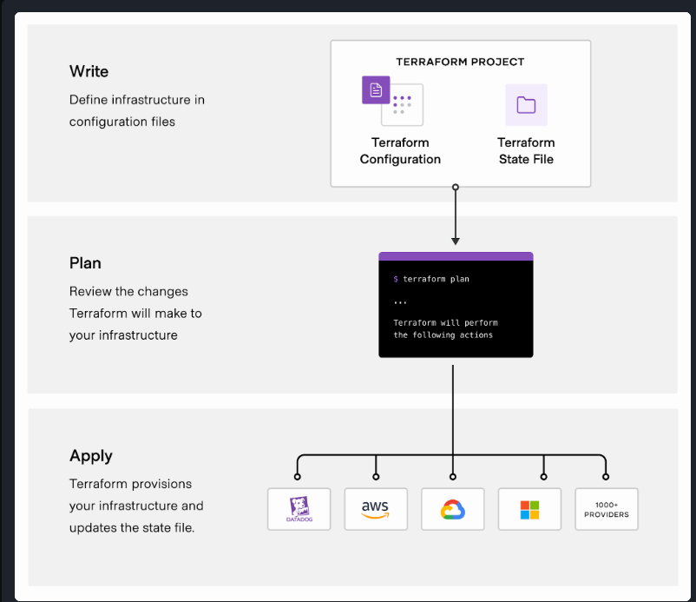

Slide 29
Terraform
Main command for Terraform use on Daily Basis Terraform init Terraform Plan :- Terraform creates an execution plan describing the infrastructure it will create, update, or destroy based on the existing infrastructure and your configuration. Terraform Apply :- On approval, Terraform performs the proposed operations in the correct order, respecting any resource dependencies. For example, if you update the properties of a VPC and change the number of virtual machines in that VPC, Terraform will recreate the VPC before scaling the virtual machines. Terraform Destroy :- it will destroy the resources

Slide 30
Terraform State file
Terraform must store state about your managed infrastructure and configuration. This state is used by Terraform to map real world resources to your configuration, keep track of metadata, and to improve performance for large infrastructures.
Terraform Modules
When you repeatedly provision collections of resources with similar configuration, such as networking resources for new development environments, you should write reusable modules to codify them. Modularizing and sharing configurations helps you standardize how you provision infrastructure and lets you quickly and predictably provision the resources you need.
Terraform registry link :- https://registry.terraform.io/browse/modules?product_intent=terraform

Slide 31
Terraform Provision :- We are creating the Resources on cloud from Terraform Script from our local machine when the Resource deployed successfully on cloud then this Process Terraform Provisioning. Terraform Variables :-
Terraform Backend :- Means we are taking the backup of existing terraform state files into the cloud Storage account

Slide 32
Terraform interview Questions
What terraform refresh command will do :- The terraform refresh command is used to reconcile the state Terraform knows about (via its state file) with the real-world infrastructure. This does not modify infrastructure but does modify the state file. Terraform Taint :- Once a resource is marked as tainted, the next plan will show that the resource will be destroyed and recreated and the next application will implement this change. What is terraform Import :- Terraform is able to import existing infrastructure. This allows you to take resources that you’ve created by some other means and bring them under Terraform management. The current implementation of Terraform import can only import resources into the state. It does not generate a configuration. Because of this, prior to running terraform import, it is necessary to write a resource configuration block manually for the resource, to which the imported object will be mapped Terraform State Lock Mechanics :- State locking happens automatically on all operations that could write state. You won’t see any message that it is happening. If state locking fails, Terraform will not continue. You can disable state locking for most commands with the -lock Terraform has a force-unlock command to manually unlock the state if unlocking failed. Command to unlock the terraform Lock :- terraform force-unlock <LOCK_ID> Where are you storing your terraform State file :- on cloud where if its S3 backend and Azure then Backend is Storage account Write the block of terraform :- S3 Backet , VPC , AWS_instance , Database , RDS if terraform state file is deleted so how you recover the current infra Details :- use the terraform import command to import the current to the local state file. How does terraform handle changes to infra resources that were not handled or managed by terraform Terraform has a feature called state drift that allows it to detect changes to infra resources that were not created or managed by terraform when terraform runs it compare that state of infra as recorded in the state file to the current state of infrastructure.

Slide 33
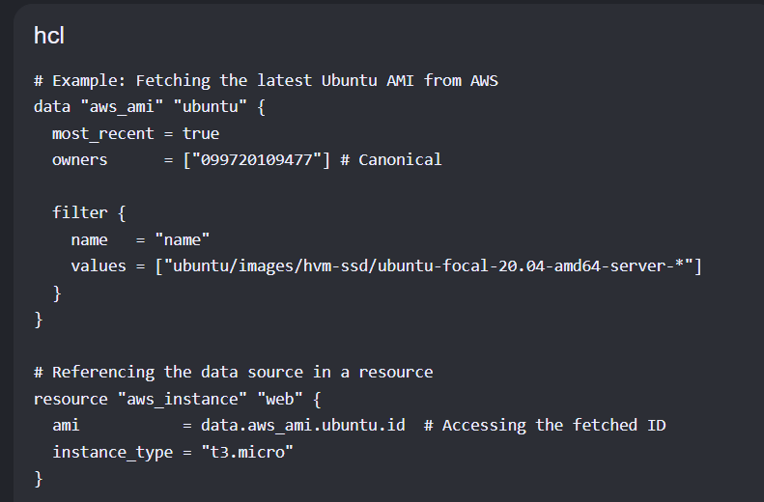
How does terraform handle the management of secrets , such as password and API Keys Terraform Provides a number of options for managing secrets , such as password and API keys , including storing secrets in Hashi Corp vault and referencing them in terraform configuration. System manager , secrets managers , Key Vault How does handle dependencies between resources. Terraform handles dependencies between resources by automatically determining between the correct order of resources creation and updates terraform tracks the dependencies between resources and ensures that resources are created and updated in the correct order to meet the dependencies. Terraform Data source :- Data sources are an abstraction that allow Terraform to reference external data. Unlike managed resources, Terraform does not manage the lifecycle of the resource or data. Data sources are intended to have no side-effects.

Slide 34
Kubernetes

